Slide 1
What is Univariate Analysis?
Analysis of one variable at a time.
Used to understand the characteristics of a dataset.
Helps identify:
Central tendency
Spread of data
Distribution pattern
Outliers
Example: Analyzing students' marks in a class.

Slide 2
Using Univariate Analysis, the teacher can answer the following questions:
✅ Central Tendency
What is the average mark of the class?
Mean = 68 marks
Median = 70 marks
Mode = 75 marks
✅ Spread of Data
Are the marks closely grouped or widely spread?
Standard Deviation = 12 marks
✅ Distribution Pattern
Do most students score around 70?
Is the distribution normal, skewed, or bimodal?
✅ Outlier Detection
Are there unusually low or high scores?
Example: One student scored 15 marks while most scored between 50–90.
The score of 15 may be identified as an outlier.

Slide 3
Types of Distribution with Real-Time Examples
1. Normal Distribution (Bell-Shaped Distribution)
Description:
Data is symmetric around the center.
Mean = Median = Mode.
Most values are concentrated near the average.
Real-Time Example: 📚 Students' Exam Scores
In a large class, most students score around 70–80 marks.
Few students score very low or very high.
The graph forms a bell shape.
Example Scores: 60, 65, 68, 70, 72, 75, 78, 80, 85
Applications:
IQ scores
Human heights
Measurement errors

Slide 4
2. Uniform Distribution
Description:
Every value has an equal chance of occurring.
The graph appears flat.
Real-Time Example: 🎲 Rolling a Fair Dice
Outcomes: 1, 2, 3, 4, 5, 6
Each number has an equal probability (1/6).
Applications:
Lottery draws
Random number generation

Slide 5
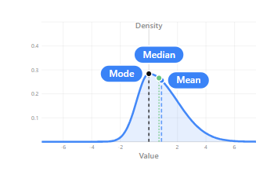
3. Skewed Distribution
Description:
Data is not symmetric.
One tail is longer than the other.
(a) Positive Skew (Right-Skewed)
Tail extends to the right.
Mean > Median > Mode.
Real-Time Example: 💰 Employee Salaries in a Company
Most employees earn ₹30,000–₹50,000.
A few managers earn ₹2,00,000+.
High salaries pull the distribution to the right.
(b) Negative Skew (Left-Skewed)
Tail extends to the left.
Mean < Median < Mode.
Real-Time Example: 🎓 Easy Examination Marks
Most students score above 80.
Very few score below 40.
Distribution tail extends toward lower marks.

Slide 6
4. Bimodal Distribution
Description:
Distribution contains two peaks (two modes).
Indicates two distinct groups in the data.
Real-Time Example: 🚗 Daily Traffic Speed Analysis
Morning traffic speed average = 30 km/hr.
Night traffic speed average = 70 km/hr.
Two peaks appear in the graph.
Applications:
Customer segmentation
Population studies
Traffic analysis

Slide 7
Detecting Outliers Using IQR
Interquartile Range (IQR)
IQR=Q3−Q1
Outlier Limits
Lower Bound:
Q1−1.5(IQR)
Upper Bound:
Q3+1.5(IQR)
Values outside these limits are considered outliers.

Slide 8
Real-Time Example: Students' Marks
Consider the marks of 10 students:
45, 50, 52, 55, 58, 60, 62, 65, 68, 95
Step 1: Find Q1 and Q3
Lower Half: 45, 50, 52, 55, 58
Q1 = 52
Upper Half: 60, 62, 65, 68, 95
Q3 = 65
Step 2: Calculate IQR
IQR=Q3−Q1IQR = Q3 - Q1IQR=Q3−Q1 IQR=65−52=13IQR = 65 - 52 = 13IQR=65−52=13 Step 3: Calculate Outlier Limits
Lower Bound
Q1−1.5(IQR)Q1 - 1.5(IQR)Q1−1.5(IQR) 52−1.5(13)52 - 1.5(13)52−1.5(13) 52−19.5=32.552 - 19.5 = 32.552−19.5=32.5 Upper Bound
Q3+1.5(IQR)Q3 + 1.5(IQR)Q3+1.5(IQR) 65+19.5=84.565 + 19.5 = 84.565+19.5=84.5 Step 4: Identify Outliers
Valid Range:
32.5≤x≤84.532.5 \leq x \leq 84.532.5≤x≤84.5 Marks:
45, 50, 52, 55, 58, 60, 62, 65, 68, 95
Since 95 > 84.5, it is an outlier.
✅ Outlier = 95

Slide 9
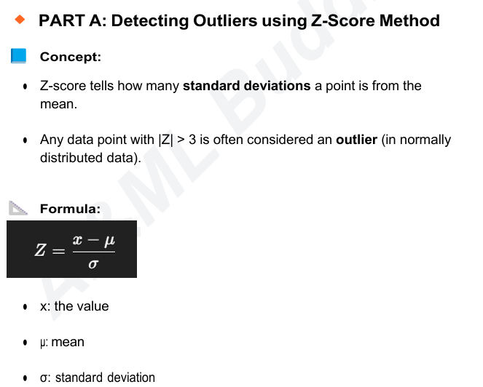

Slide 10
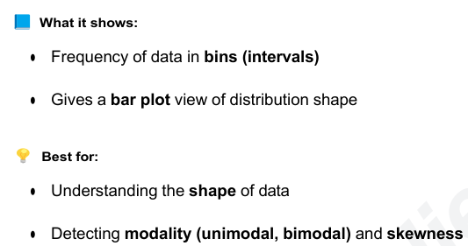
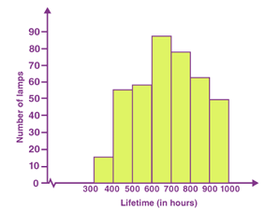
Visualization Techniques
Objective:
● Visualize how data is distributed
● Spot patterns, skewness, and outliers visually 1. Histogram
● Support numeric summaries (mean, median, std) with graphs
Histogram

Slide 11
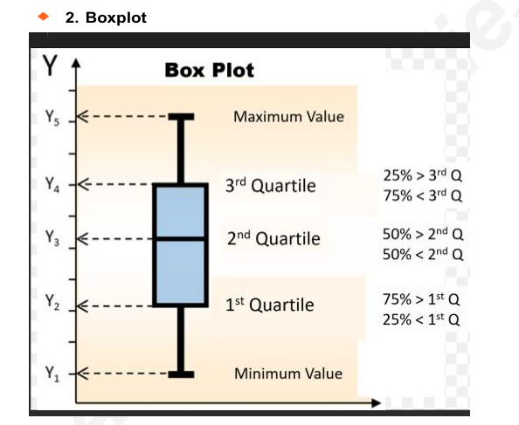
What it shows:
● Five-number summary: ○ Min, Q1, Median, Q3, Max
● Visual detection of: ○ Outliers (dots beyond whiskers)
● Skewness (if box is lopsided)
● Spread (length of box and whiskers)

Slide 12
